Slide 1
SAN INVESTIGATION
Date
Name
Position, Department,
Unit
Renesas System Design Co., Ltd.

Slide 2
AGENDA
SAN OVERVIEW Page 3
Introduction
Three Kinds of safety mechanisms
Software Operations
CLASSIFICATION OF SATETY MACHANISMS Page 8
Abbreviation
EDC for Video Input Module (VIN)
Display data check by using Display Output Checker(DOC)
Display Output Comparator
Sync Interval Checker (VIN)
Frozen Image Detection (VIN)
REFERENCE Page 15

Slide 3
SAN OVERVIEW

Slide 4
INTRODUCTION
SAN function : the recommended usage of the safety mechanism (SM) of the R-Car series
Each section describes a safety mechanism and contains the following sub-sections:
Overview: Description of the overview of each safety mechanism.
• Hardware Description: Description of the safety mechanism of hardware
• Recommended Usage: Any possible recommendations to bear in mind during the usage of the SoC to prevent possible misbehaviors; it also gives suggestions to use possible independent modules in redundant configuration and required configuration to minimize interference when not all module functions are used.
• Fault Control: Definition of the assumed fault reaction and control.
• Operation: Description of the software test description including references to registers, flow charts of software tests procedures.
• Fault Detection of Safety Mechanism: Description of the fault detection within the safety mechanism itself.

Slide 5
Three Kinds of safety mechanisms
The safety mechanisms can be classified into the following three kinds.
IP safety mechanisms:
Safety mechanisms which are realized by a dedicated circuit within the module. The circuit may require driver software.
On-chip safety mechanisms:
Safety mechanisms which are realized by some cooperative circuits for dedicated use within the SoC. The circuits may require driver software.
System-level safety mechanisms:
Safety mechanisms which are realized in software or as an external mechanism.

Slide 6
Software Operations
The software operations are classified by their execution timing into five types:
Initial Setting: This procedure enables a safety mechanism implemented in hardware
Initial Check : This procedure detects faults of the safety mechanisms.
Periodical Check: This procedure shall be periodically executed using the timer during system operation
On Operation Check: This procedure shall be executed every time the safety-related operation is performed
Miscellaneous: This procedure shall be executed at the specified timing

Slide 7
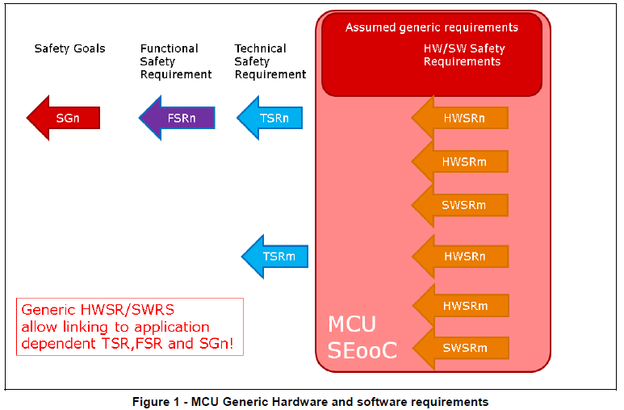
Safety Requirement Specification
Analysis from HW team
CFMEDA
HW-SAN
SW-SAN
S-SRS
The hardware/software safety requirement specification defines the detailed specification to achieve the technical safety requirements. These requirements are implemented into design, then the design is updated during
design phase, if required, to achieve the requirements.
H-SRS

Slide 8
CLASSIFICATION OF SAFETY MECHANISMS

Slide 9
ABBREVIATION
Term | Definition
EDC | Error Detection Code
VIN | Video INput module
DU | Display Unit
DOC | Display Output Checker
DISCOM | Display Output Comparison
Refer to section 2 in Reference [1].

Slide 10
EDC for Video Input Module
Overview:
EDC protection is applied to the LUT-RAM in the Vin (detected of Y, Cb and Cr)
Recommended Usage:
EDC check shall be enabled.
Fault Control:
When an EDC error is detected , the error notified to MFIS module shall be reported to the external systems through FSCLKST# pin (Refer to section 5.9, Multifunctional Interface, in Reference [1])
Operation:
[Initial Setting] : Refer to section 4.3.8.5 in Reference [1]
[Error detected]: None
Notes:
Hardware Description: refer to 4.3.8.2 in “R-Car Series, 3rd Generation Hardware Description For Functional Safety Ver. 20170731”
MFIS: an error management module that manages the error signal received from each module.
This module reflects the received error signal in register and notify the error to FSCLKST# external pin or INTC.
Refer to section 5.9.2 in “R-Car Series, 3rd Generation Hardware Description For Functional Safety Ver. 20170731”.

Slide 11
Display data check by using Display Output Checker (DOC)
Overview:
The display output checker (DOC) is used to check images from the Display Unit.
DOC detect faults by comparing the each pixel color of arbitrary rectangular area of the image with the expected color range. (Refer to 5.12.1 in Reference [1])
Recommended Usage:
Display data shall be compared with the expected value using DOC if the expected value can be prepared.
However, this module can be also treated as non-safety-related function.
Fault Control:
When a compare error is detected, an interrupt is generated through the INTC.
On interrupt, the error shall be reported to the external systems through RFSO external pins(Refer to section 5.10)
Operation:
Check the display data using DOC while safety-related image data is output.
Notes:
Hardware Description: refer to section 36 in “R-Car Series, 3rd Generation User’s Manual: Hardware Rev 0.55 ”
RFSO: a module which consists interval and time-out timers and has output signals to the outside of the SoC. This module can be used as a trigger and time-out detection for Runtime Test, trigger for Periodical Checks, internal watchdog
timer, and for fault notification to the external MCU.
Operation: Refer to section 36.3 in “ R-Car Series, 3rd Generation User’s Manual: Hardware Rev 0.55 “

Slide 12
Display Output Comparator
Overview:
Display Output Compare Unit (DISCOM) is used to check the input or blending images of VSPD in VSP2. (Refer to 5.13.1 in Reference [1])
Recommended Usage:
There are two usages: output signal path and input signal path. Either of them can be used at the same time.
(Refer to section 5.13.3 in Reference [1])
Fault Control:
When a compare error is detected, an interrupt is generated through the INTC.
On interrupt, the error shall be reported to the external systems through RFSO external pins
(Refer to section 5.10 in Reference [1])
Operation:
Refer to 5.13.5 in Reference [1]
Notes:
Hardware Description: refer to 5.13.2 in “R-Car Series, 3rd Generation Hardware Description For Functional Safety Ver. 20170731”

Slide 13
Sync Interval Checker (VIN)
Overview:
This safety mechanism checks the interval of sync signals.
The expected range of each sync interval can be configured by software.
Refer to section 5.14.1 in Reference [1]
Recommended Usage:
In case of CSI2 data input, monitoring VSYNC and CLKENB signals shall be enabled.
Fault Control:
When a sync interval error is detected ,the error notified to MFIS module shall be reported to the external systems through FSCLKST# pin (Refer to section 5.9, Multifunctional Interface)
Operation:
[Initial Setting] : Refer to section 4.3.8.5 in Reference [1]
[Error detected]: None
Notes:
Hardware Description: refer to 5.14.2 in “R-Car Series, 3rd Generation Hardware Description For Functional Safety Ver. 20170731”

Slide 14
Frozen Image Detection(VIN)
Overview:
This safety mechanism detects frozen image by comparing the CRC value of a frame with the CRC value of the pervious frame of the captured image data.
Recommended Usage:
Refer to section 5.16.3 for in Reference [1]
Fault Control:
When frozen image is detected, it shall be reported to the external systems through RFSO external pins (Refer to section 5.10, Multifunctional Interface, in Reference [1])
Operation:
Refer to section 5.16.5 in Reference [1]
Notes:
Hardware Description: Refer to section 5.14.2 and 5.16.2 in “R-Car Series, 3rd Generation Hardware Description For Functional Safety Ver. 20170731”

Slide 15
REFERENCE

Slide 16
Reference
[1] : R-Car Series, 3rd Generation Safety Application Note (LLWEB-10003285)

Slide 17
Renesas.com

